Slide 1




Cybercrime and Digital Forensics (COM622)
Department of Science & Engineering
Solent University
Week 5 Lecture: Analysis and Reporting
Dr Daniel Olabanji

Slide 2

Session Overview
Digital Forensic and Investigation definitions
KSA of Cybercrime investigator
Sample of Tool for Cyber Forensic Analysis

Slide 3
Digital Forensic and Investigations Definitions
Digital Forensic Investigation: is a process that uses scientific methods and the knowledge of the technology to examine digital devices that can be entered into a court of law to answer questions about digital events, in the legal system.
Digital Devices are things like: Hard disks, DVD, Flash memories etc.
Digital Evidence refers to a Digital device that contains reliable information to support or contest a hypothesis.
A digital Investigation is a process that test hypotheses that we made about answering questions related to digital evidence – Scientific methods are adopted.
A digital Forensic Investigation is a process that uses scientific methods and the knowledge of the technology to examine digital devices that can be entered into a court of law to answer questions about digital events, in the legal system.

Slide 4
Digital Forensic and Investigations Processes
A Live Analysis: Use the Operating System or resources of the system being investigated to find evidence, the risk is that the software could be altered and hence may hide and falsify the data
A Dead Analysis: Use the trusted applications (Booted from disk) to find evidence, ideal but not possible all the time.
System Preservation
Evidence Searching
Event Reconstruction
Court
Start the investigation

Slide 5
Digital Forensic and Investigations Processes
Evidence
  IT systems, media, and documentation
  A trained officer should be used to do this.
Audit & Inspection
  Log book
    Must be maintained
    Must be secured
    Must be taken to court
  Booking out
    All property/exhibits must be booked out prior to analysis.
  Record
    Details of exhibit numbers/bag seal numbers
    Details of system/media
    Damage found
    Other property found
    Photograph of system (optional)
    Comparison of system date/time with actual date/time.

Slide 6
Starting the Investigation (What To Look For and What To Prepare)
Evidence
  IT systems, media, and documentation
  A trained officer should be used to do this.
Audit & Inspection
  Log book
    Must be maintained
    Must be secured
    Must be taken to court
  Booking out
    All property/exhibits must be booked out prior to analysis.
  Record
    Details of exhibit numbers/bag seal numbers
    Details of system/media
    Damage found
    Other property found
    Photograph of system (optional)
    Comparison of system date/time with actual date/time.

Slide 7
System Preservation
This is a process of preserving the condition of the digital crime scene and reduce the amount of evidence that are overwritten
  Secure the scene physically and electronically
    Disconnect the network connections, or plug into an empty hub or switch. If possible set a network filter to prevent the perpetrator to delete files from a remote system
    Decide whether to switch off or leave alone
      Switch off the system for dead analysis, make a duplicate for all data. Write blockers can be use to prevent evidence from being overwritten
      Kill or suspend suspicious processes, for live analysis, reboot from a trusted application
    Cryptographic hashes must be used on saved data to show later that data have not been tempted with.
    On-site imaging and previewing, disk imaging using tools
    Other forensic activities, depending on the expertise of the investigator and the legal requirements

Slide 8
Evidence Searching
Evidence searching refers to the process of identifying, collecting, and analysing digital data that can be used in legal proceedings. This involves several key steps:
Identification: Determining which devices and data sources may contain relevant information.
Preservation: Ensuring that the data is not altered or tampered with during the investigation.
Extraction: Retrieving the data from the identified sources.
Analysis: Examining the extracted data to find evidence.
Documentation and Presentation: Recording the findings in a detailed report and presenting the evidence in a manner that is admissible in court.

Slide 9
Evidence Searching (What to look)
When investigating a web-browsing habits, check web browser cache, history file, bookmarks
When investigating Linux intrusion, check for rootkit, user account
Look for images, then list all files with JPG extensions
Search by names, content, temporal data ( access time etc…)
Network data, search for packets from specific source IP or packets going to specific port, search for packets’ contents

Slide 10
Data Carving
Data Carving is the process of re-assembling files from fragments in the absence of file system metadata.
Usage of data carving
  Storage media recovery: USB, CD/DVD, computer hard drive, camera memory card…
  Data carving file types: Microsoft Office documents, images (e.g. JPEG, PNG), encrypted files, compressed files (e.g. zip files), database files, music files, email messages….
Notes:
Users use the extension to indicate what software should be used to open the file
What happens with the following scenario?
Change the file abc.jpg to abc.png
Change the file abc.jpg to abc.doc
So the file becomes un-openable
But what happened to the data?

Slide 11
Type of Data Carving
Header-Footer Carving: This method looks for specific starting (header) and ending (footer) signatures of files. For example, a JPEG file typically starts with the bytes 0xFFD8 and ends with 0xFFD9.
Content-Based Carving: This technique examines the content for patterns to identify files. It doesn’t rely on file signatures but rather on the structure and content of the data.
Fragment Carving: This involves reconstructing files from fragments scattered across the storage medium. It’s often used when files are fragmented and not stored contiguously.
Semantic Carving: This advanced method uses knowledge of the file format and its semantics to piece together data. It can be more accurate but also more complex.

Slide 12
File recap
A file is an object on a computer that stores data, information, settings, or commands used with a computer program. File can literally mean a collection of data or information stored on a computer under a single name.
User’s point of view: name, content, and extension.
Common extensions
  Pictures: .jpg, .png, .gif
  Documents: .docx, .ppt, .pdf,
  Source code: .py, .c, .cpp, .pl, .m
  Executables: .exe, .dll, .sys
  Video: .mpg, .avi, .mkv
Notes:
Users use the extension to indicate what software should be used to open the file
What happens with the following scenario?
Change the file abc.jpg to abc.png
Change the file abc.jpg to abc.doc
So the file becomes un-openable
But what happened to the data?

Slide 13
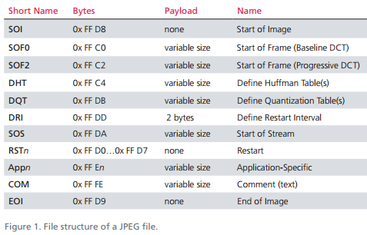
File Signature
A File signature is a constant used to identify the format of a file
Usually presented as a header: the first few bytes of the file, such as JPEG starts with “0xFFD8” and PDF starts with “0x25 50 44 46” “%PDF”
May be included as a footer , such as JPEG ends with “0xFFD9” and PDF ends with “0x0A 25 25 45 4F 46”
Sometimes internal markers might be used as well, such as JPEG files use a series of markers to mark internal structure, each starting as FF xx
Notes:
Single file
Compound file
hash

Slide 14
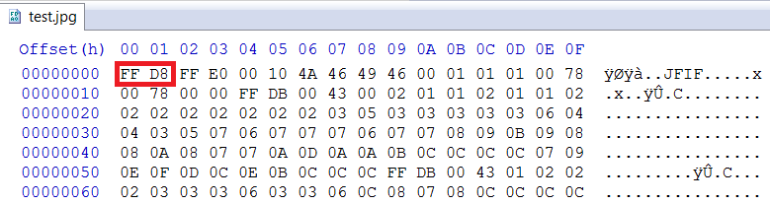
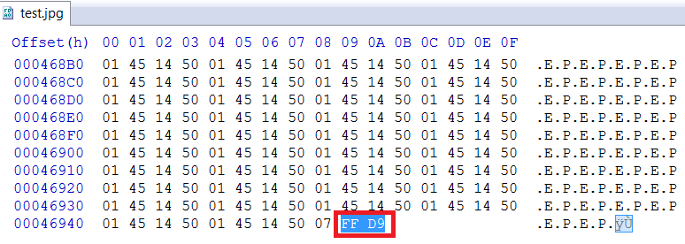
Header Footer Carving
Header-Footer Carving: This method looks for specific starting (header) and ending (footer)

Slide 15
Header Footer Carving Works
1.Identification of Headers and Footers:
  Headers: These are specific byte sequences that mark the beginning of a file. For example, a JPEG file typically starts with 0xFFD8.
  Footers: These are specific byte sequences that mark the end of a file. For example, a JPEG file typically ends with 0xFFD9.
Scanning the Storage Medium:
  The forensic tool scans the entire storage medium (like a hard drive or memory card) to locate these header and footer signatures.
Extracting Data:
  Once a header is found, the tool continues to read the data until it finds the corresponding footer.
  The data between the header and footer is then extracted and saved as a separate file.

Slide 16
Header Footer Carving Advantage and Limitation
Advantages:
  Simplicity: It’s straightforward and doesn’t require knowledge of the file system.
  Effectiveness: Works well for files with distinct headers and footers.
Limitations:
  Fragmentation: If a file is fragmented, header-footer carving might not recover the entire file.
  False Positives: It might incorrectly identify data as part of a file if similar byte sequences are found.

Slide 17
Content-based Carving
Content-based carving is a sophisticated technique used in digital forensics to recover files based on their internal content rather than relying on specific headers and footers.
How Content-Based Carving Works
Content Structure Analysis:
  This method examines the internal structure of the data. For example, it looks for patterns or structures typical of certain file types, such as the layout of an HTML or XML file.
Content Characteristics:
    Character Count: The number of characters in a text file.
    Text/Language Recognition: Identifying the language or type of text.
    White and Black Listing: Filtering data based on predefined lists of acceptable or unacceptable content.
    Statistical Attributes: Using statistical methods to identify patterns in the data.
    Information Entropy: Measuring the randomness or predictability of the data.

Slide 18
Content-based Carving Advantage and Limitation
Advantages and Limitations
Advantages:
  Versatility: Can recover files even when headers and footers are missing or obfuscated.
  Accuracy: More precise in identifying file types based on content.
Limitations:
  Complexity: Requires more computational resources and sophisticated algorithms.
  False Positives: May incorrectly identify data as part of a file if the content patterns are similar.
Content-based carving is particularly useful in scenarios where traditional header-footer carving fails, such as with fragmented files or files with altered headers and footers.

Slide 19
Data Carving Tools
Proprietary tools: FTK and EnCase
Opensource applications
  Foremost (simple and advanced carving)
  Scalpel (simple and advanced carving)
    Specific carvers
  Adroit Photo Recovery: very effective on photos
  Reglookup: recovers removed registry entries
  Libpff: recovers removed emails from PST files

Slide 20
Data Carving Problem
Time Consuming
Many unreadable invalid and partial results
More data out than in
No offset/sector/cluster reference to input data

Slide 21
Event Reconstruction
Event reconstruction in digital forensics is the process of piecing together digital evidence to understand the sequence of events that occurred during an incident. This involves several key steps:
Data Collection: Gathering all relevant digital evidence from various sources such as computers, mobile devices, network logs, and cloud storage.
Timeline Creation: Organizing the collected data chronologically to create a timeline of events. This helps in understanding the sequence and timing of actions.
Correlation and Analysis: Correlating different pieces of evidence to identify relationships and patterns. This step often involves using specialized forensic tools to analyze data and draw conclusions.
Hypothesis Testing: Developing and testing hypotheses about what happened based on the evidence. Investigators may create multiple scenarios and use the evidence to support or refute each one.
Reporting: Documenting the findings in a detailed report that can be used in legal proceedings. This report should clearly explain the reconstructed events and the evidence supporting them.

Slide 22
Court Preparation
Legal Compliance:
  Ensure all evidence collection and analysis procedures comply with legal standards and regulations.
  Obtain necessary warrants and authorizations.
Presentation Preparation:
  Work closely with legal teams to understand the case and the role of digital evidence.
  Prepare visual aids and clear explanations to help the court understand the technical aspects of the evidence.
Expert Testimony:
  Digital forensic experts may be required to testify in court, explaining their findings and the methods used to obtain them.
  They must be prepared to answer questions and defend their analysis under cross-examination.
Effective court preparation ensures that digital evidence is presented in a manner that is understandable, reliable, and legally admissible.

Slide 23
Court Document
Search Warrant
Procedures of the investigation
Forensic tool reports
Extracted evidences
Witness statement
Formal report

Slide 24
KSA of Cybercrime investigator
A Cybercrime Investigator needs a combination of knowledge, skills, and abilities (KSA) to effectively perform their role. The KSA is also important for training cybercrime or Digital crime investigator to note and work hard and smart in acquiring such knowledge, skill and ability.
Knowledge
Computer Networking Concepts: Understanding network protocols and security methodologies.
Cybersecurity Principles: Familiarity with cybersecurity and privacy principles, threats, and vulnerabilities.
Legal and Ethical Standards: Knowledge of laws, regulations, and ethical guidelines related to cybersecurity and digital evidence.
Digital Forensics: Understanding techniques for collecting, preserving, and analysing digital evidence.

Slide 25
KSA of Cybercrime investigator
Skills
Analytical Skills: Ability to analyse complex data and identify patterns or anomalies.
Technical Proficiency: Proficiency in using forensic tools and software to extract and analyse digital evidence.
Communication Skills: Ability to clearly document findings and present them in a manner understandable to non-technical audiences, including in court.
Abilities
Attention to Detail: Meticulous attention to detail to ensure the accuracy and integrity of evidence.
Problem-Solving: Strong problem-solving skills to develop and test hypotheses about cyber incident¹.
Critical Thinking: Ability to think critically and make informed decisions based on the evidence.
These KSAs are essential for a Cybercrime Investigator to effectively identify, collect, and analyse digital evidence, and to present their findings in legal contexts.

Slide 26



Sample of Tool for Cyber Forensic Analysis
Here are some of the popular tools used in cyber forensic analysis:
Autopsy/The Sleuth Kit: This is a well-known open-source digital forensics platform that helps in analysing hard drives and smartphones. It provides a graphical interface to The Sleuth Kit and other digital forensics tools.
FTK Imager: Developed by AccessData, FTK Imager is used to create forensic images of hard drives, CDs, and USB devices. It allows investigators to preview data and recover deleted files.
Volatility: An open-source memory forensics framework for analysing volatile memory (RAM) dumps. It’s widely used for investigating malware infections and other memory-based attacks.

Slide 27


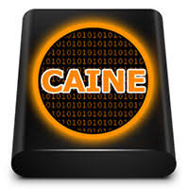
Sample of Tool for Cyber Forensic Analysis
4. Cellebrite UFED: A leading tool for mobile device forensics, Cellebrite UFED can extract data from a wide range of mobile devices, including smartphones and tablets.
5. Wireshark: A network protocol analyser that captures and analyses network traffic in real-time. It’s useful for investigating network-based incidents and understanding network behaviour.
6. CAINE (Computer Aided Investigative Environment): A Linux-based forensic platform that provides a comprehensive set of tools for digital forensics investigations.

Slide 28
Reference
  Carrier Brian (2005) “ File System Forensic Analysis”, Addison-Wesley
  Casey Eoghan (2004) “Digital Evidence and Computer Crime” 2nd Ed London Academic Press
  Mandia Kevin, Chris Prosise, Matt Pepe (2003) “ Incident Response and Computer Forensics” MacGraw Hill

